Slide 1
A short history of using
in research and tech companies
Vienna R Meetup, Dec 17th
Christoph Töglhofer

Slide 2
ctoegi
Christoph Töglhofer

Slide 3
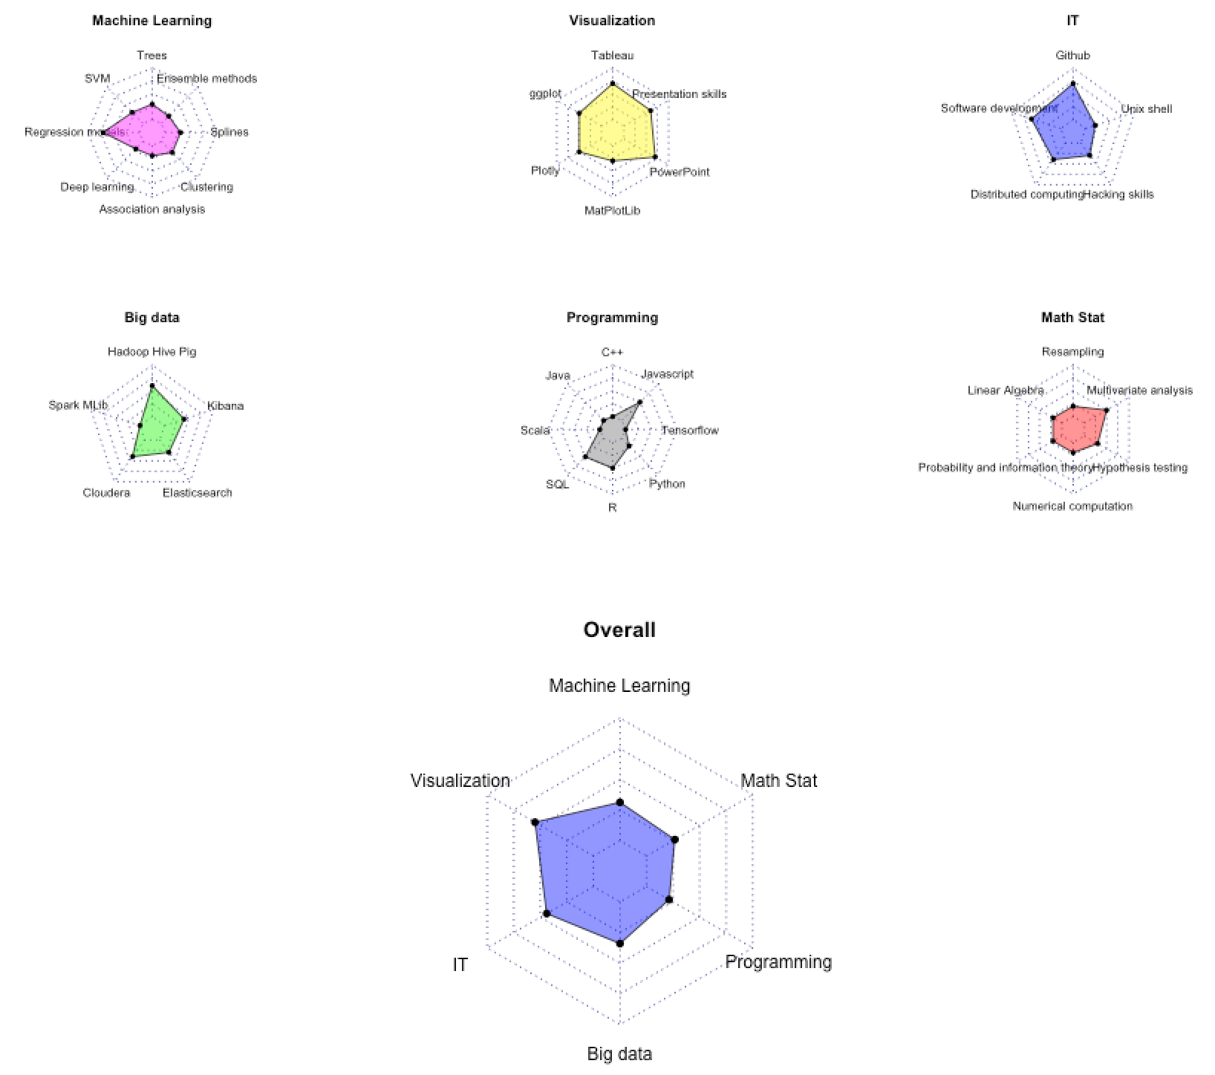
https://non-productivity-linked-ideas.shinyapps.io/DataScienceSkillEvaluation/
https://non-productivity-linked-ideas.shinyapps.io/DataScienceSkillEvaluation/

Slide 4
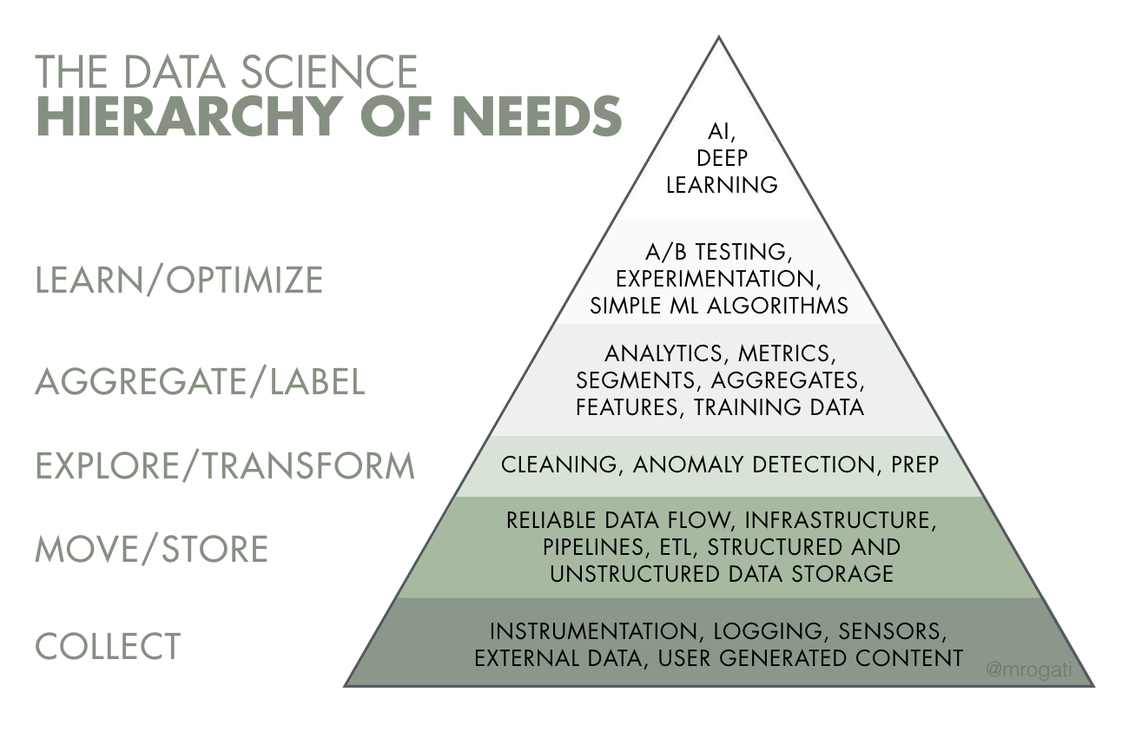
Source: Monica Rogati’s Medium post “The AI Hierarchy of Needs”

Slide 5
A T

Slide 6


Slide 7
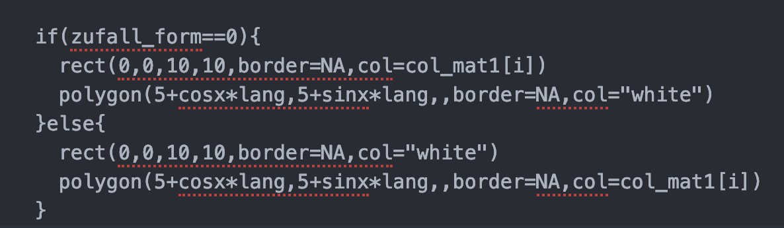

Slide 8

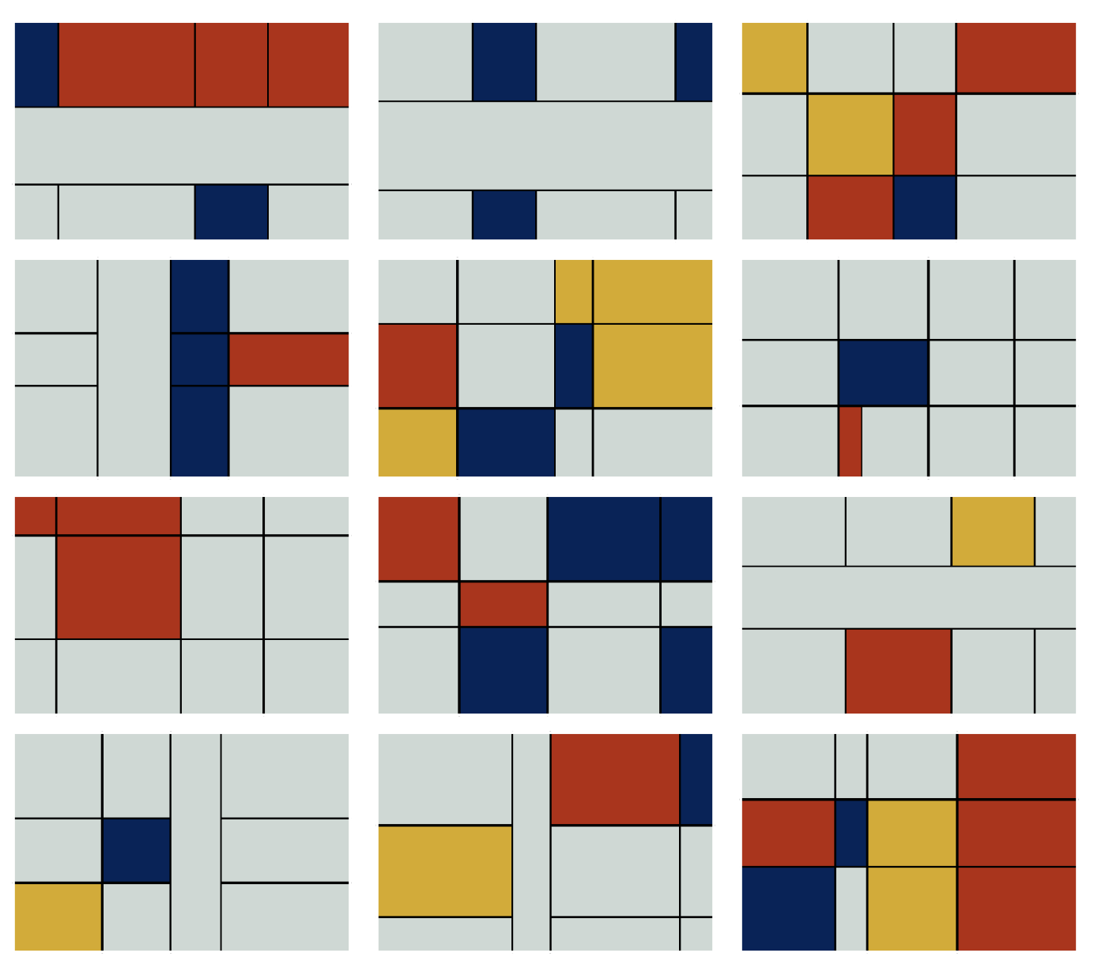
https://non-productivity-linked-ideas.shinyapps.io/Art_plot/

Slide 9
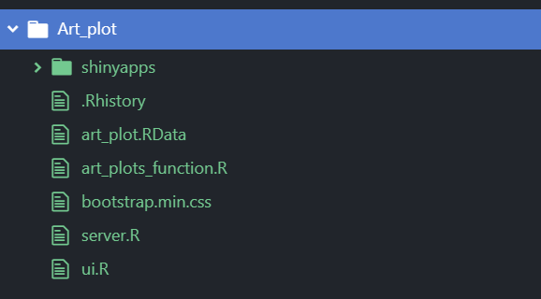
https://non-productivity-linked-ideas.shinyapps.io/Art_plot/

Slide 10
isk
is a combination of the probability of an event
and its potential impact

Slide 11
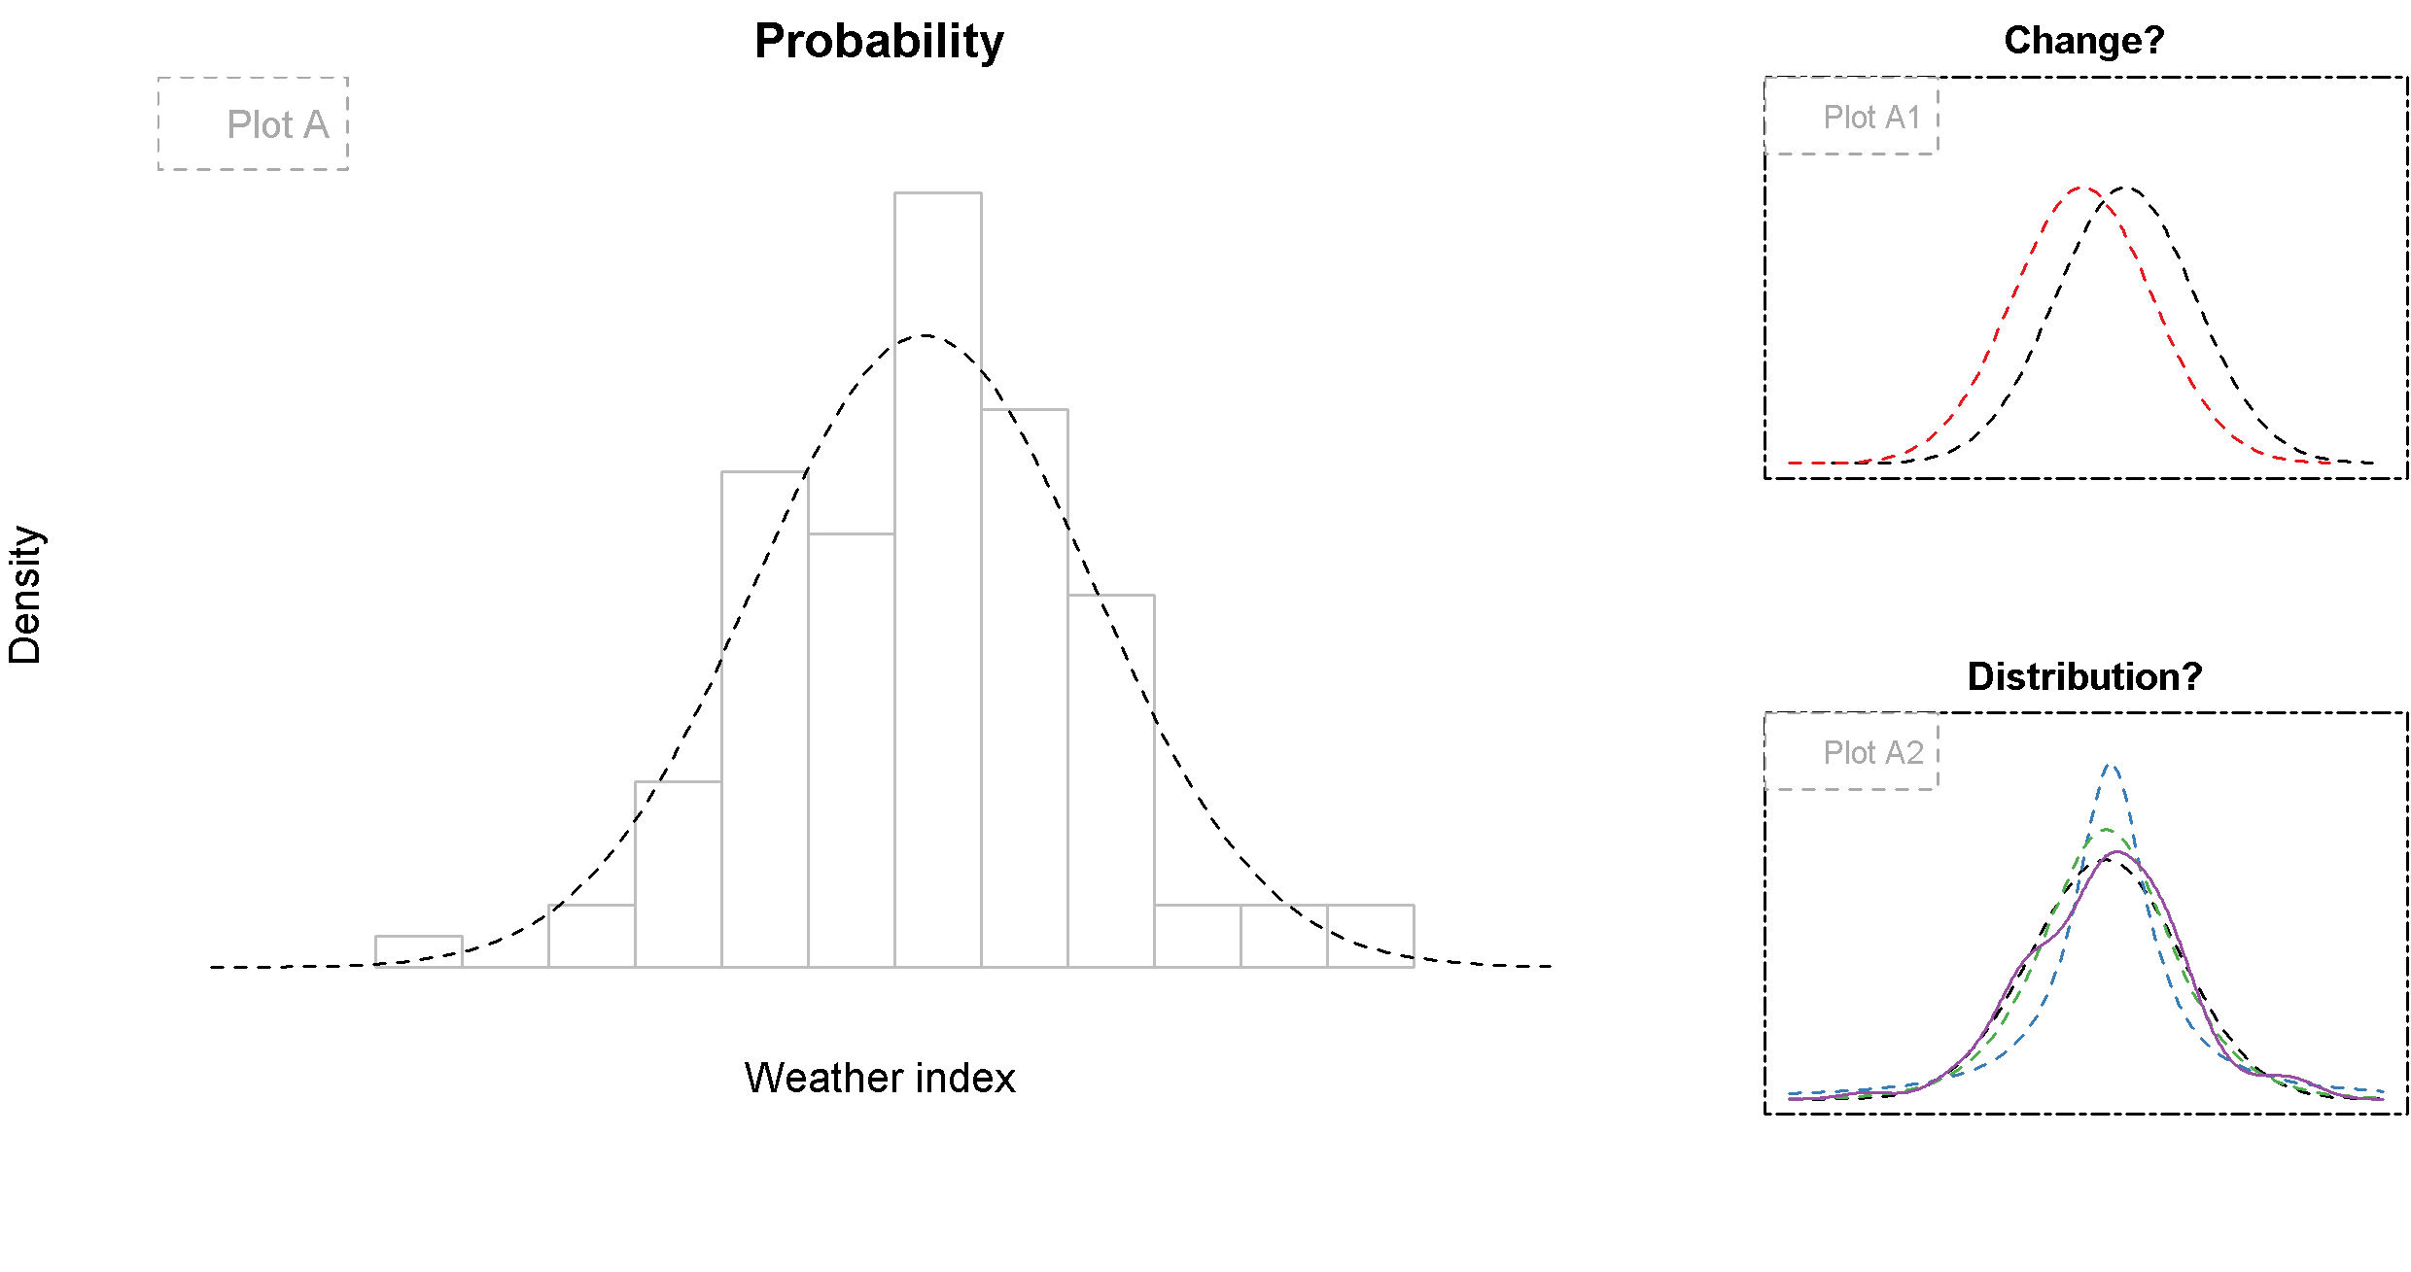
C. Töglhofer, 2011: From Climate Variability to Weather Risk: The Impact of Snow Conditions on Tourism Demand in Austrian Ski Areas

Slide 12
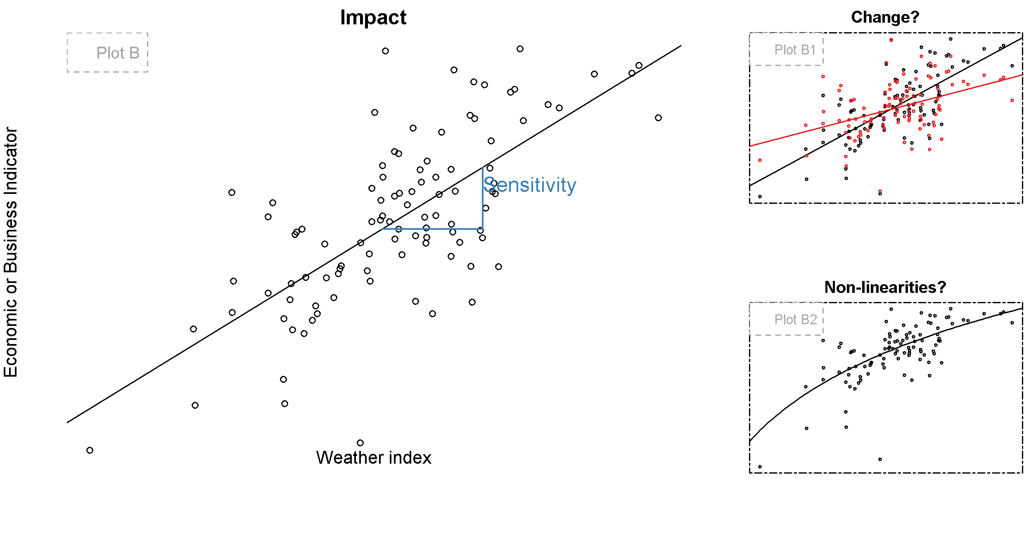

Slide 13
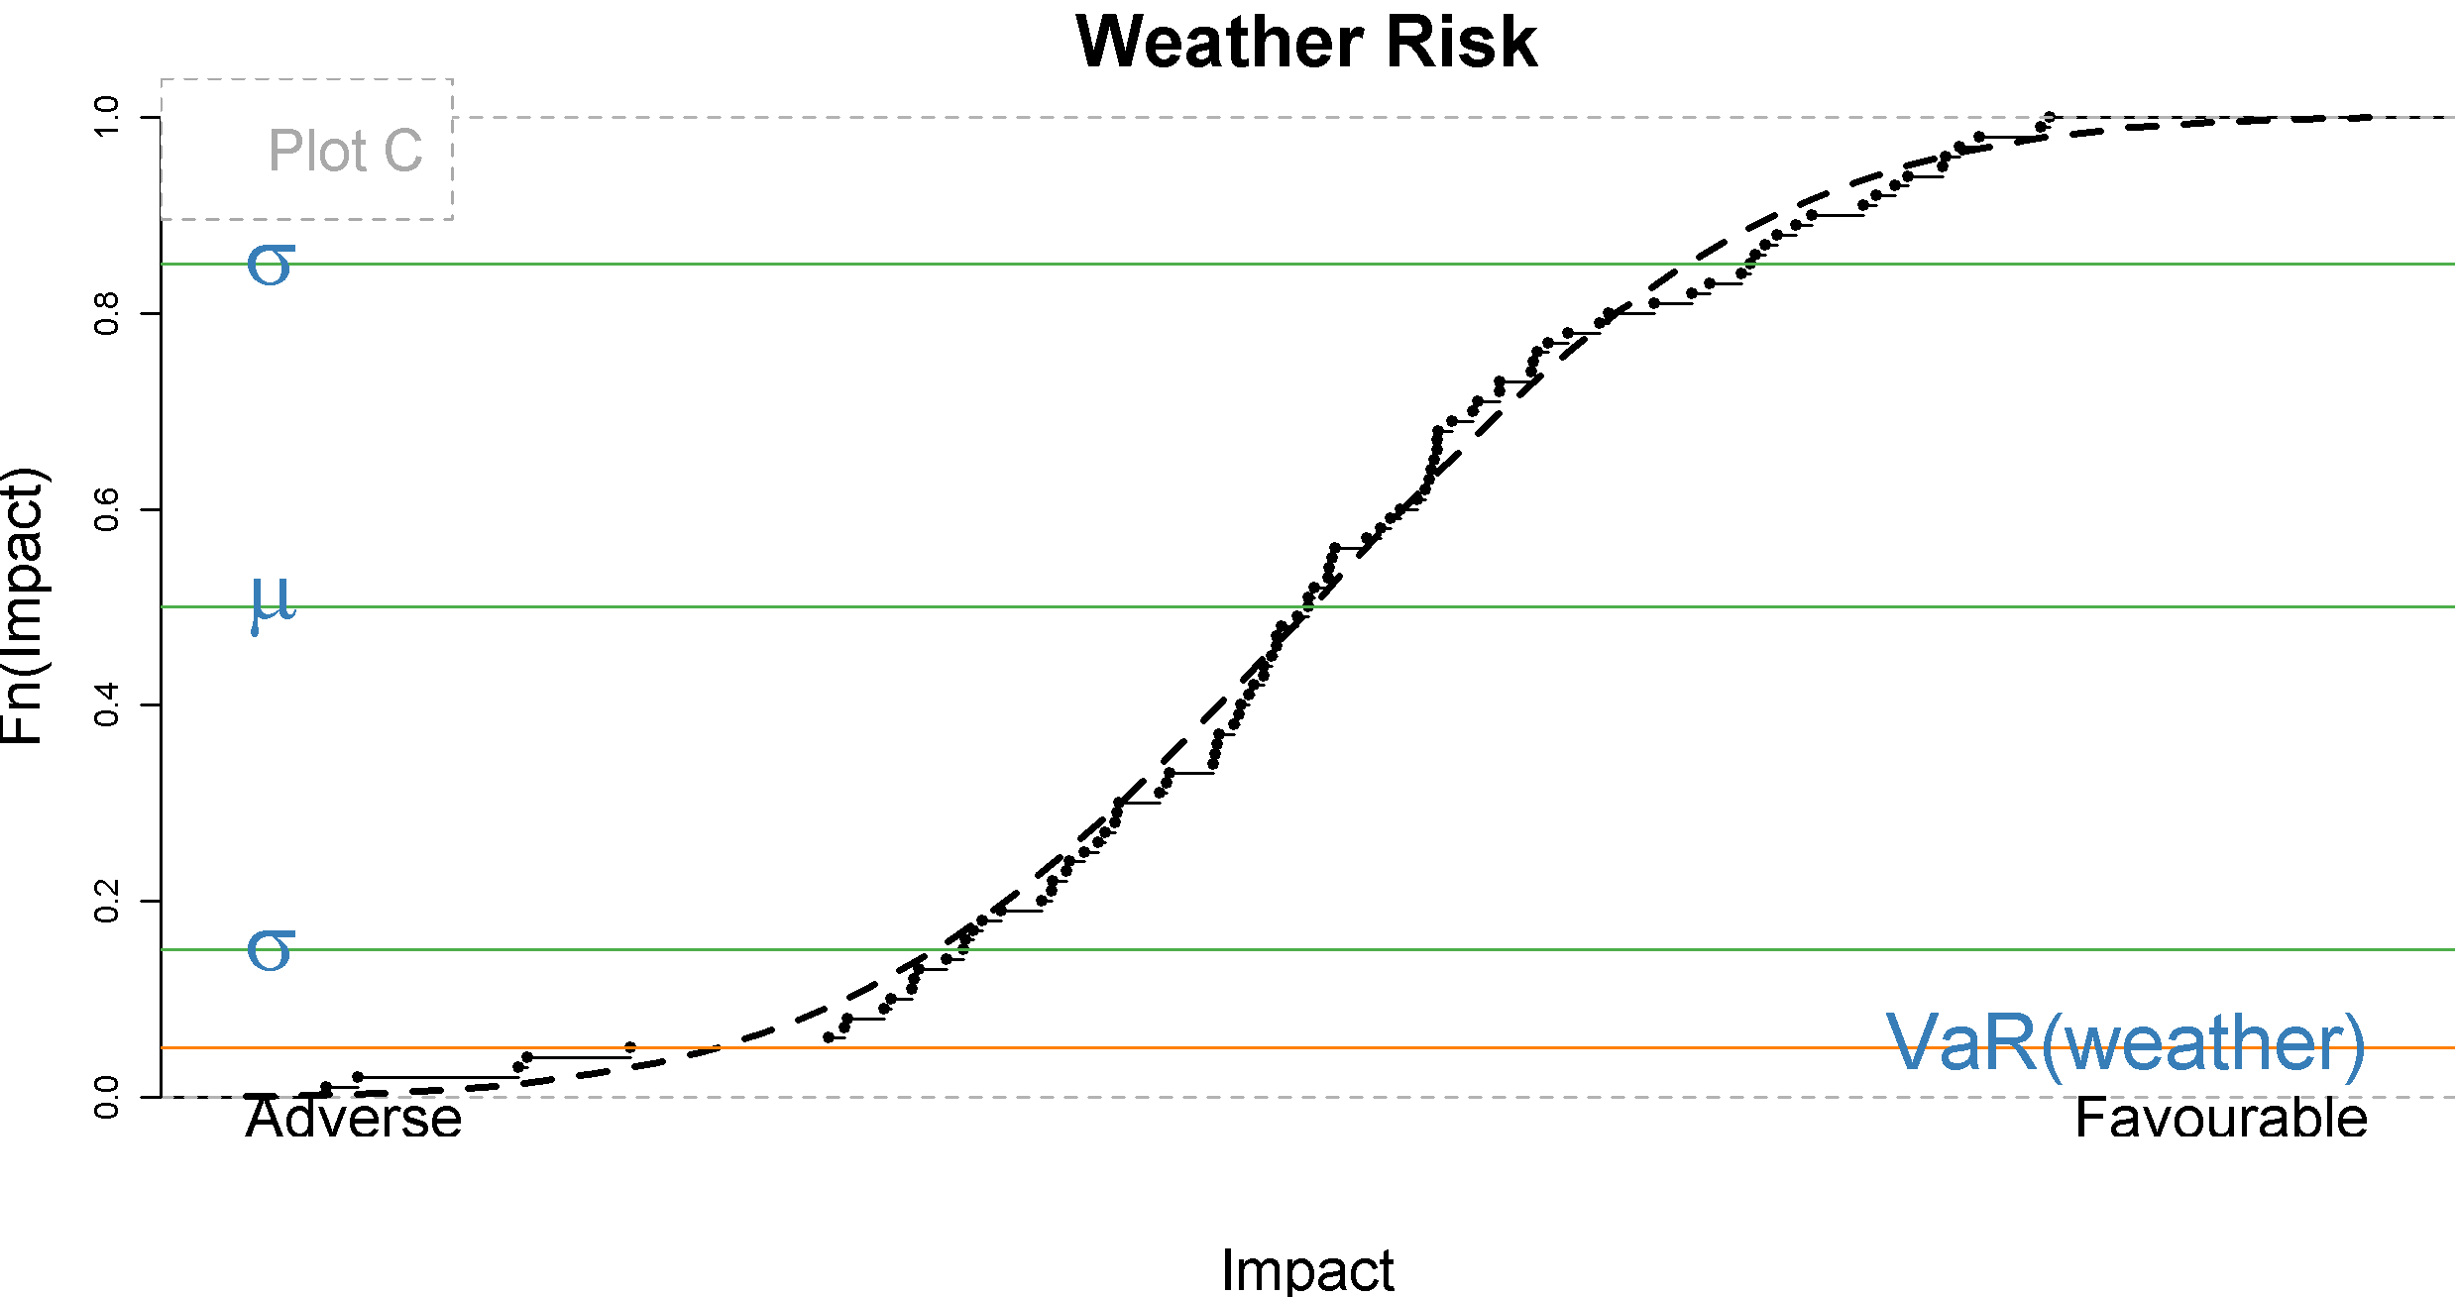

Slide 14
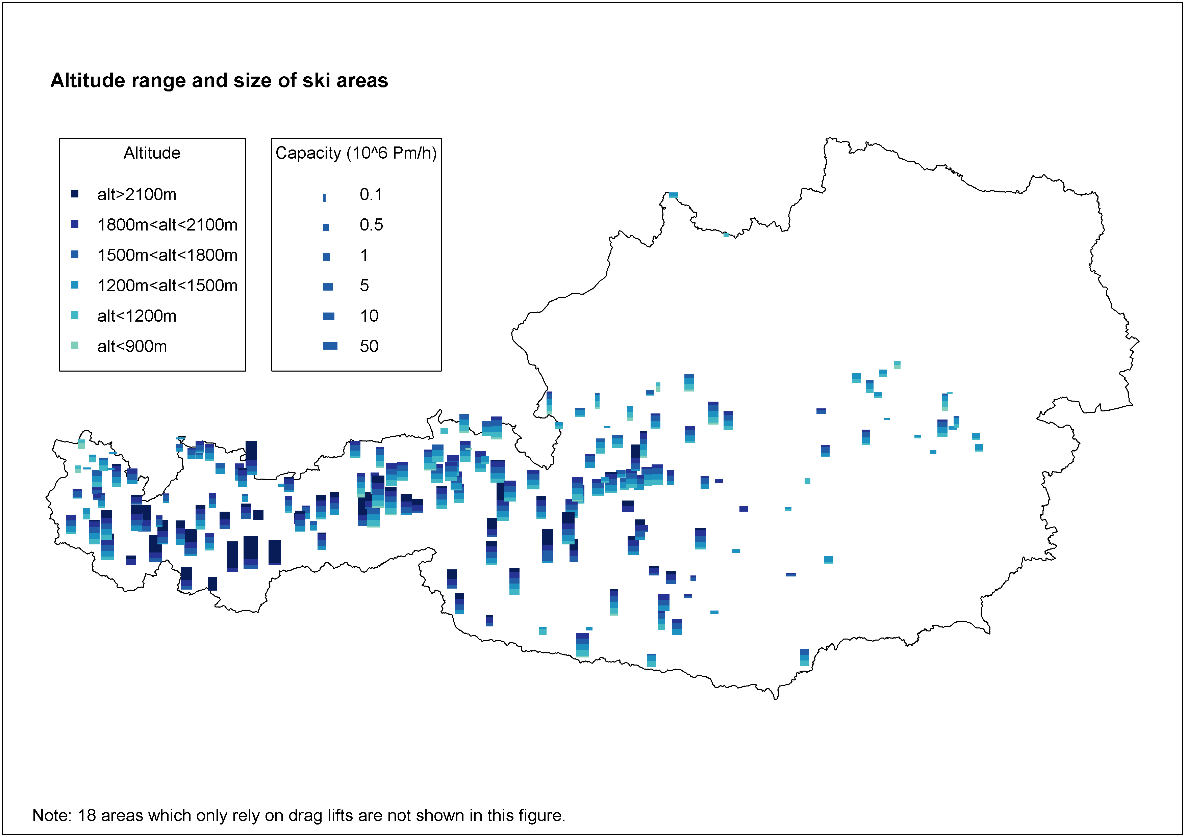

Slide 15
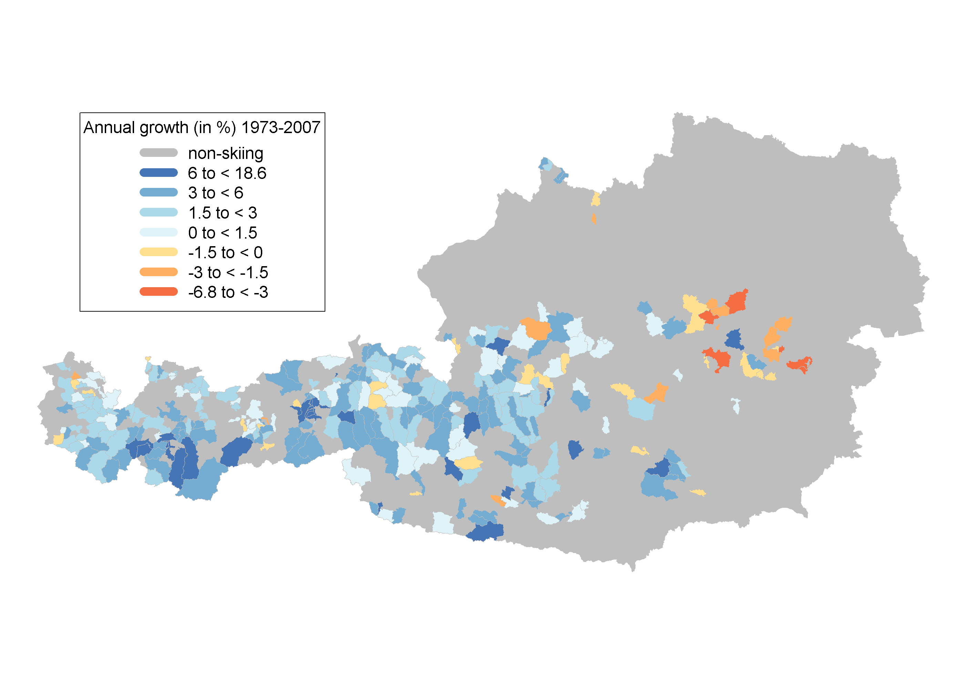
Overnight Stays

Slide 16
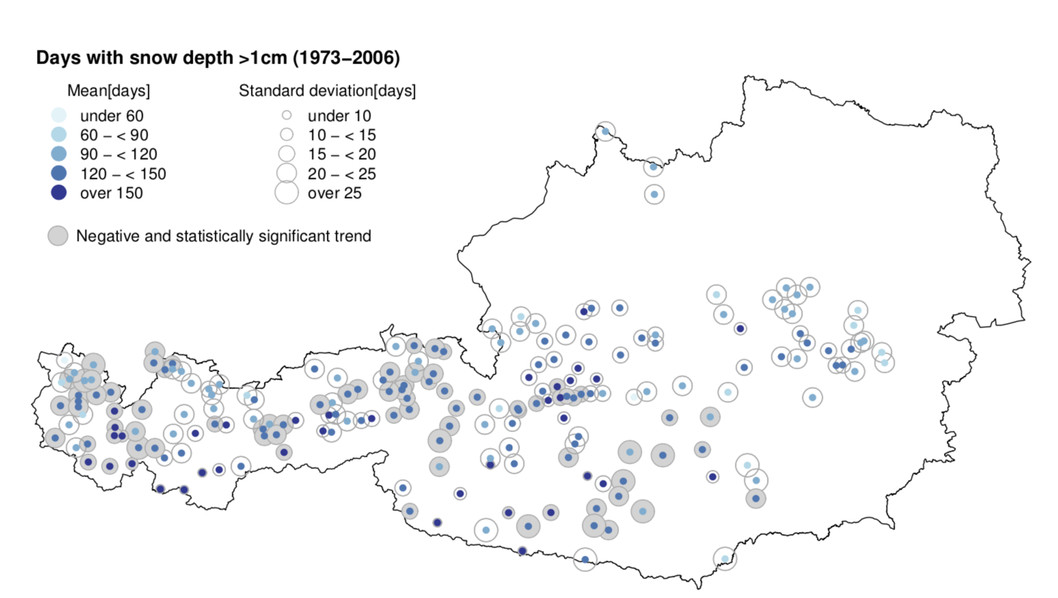

Slide 17
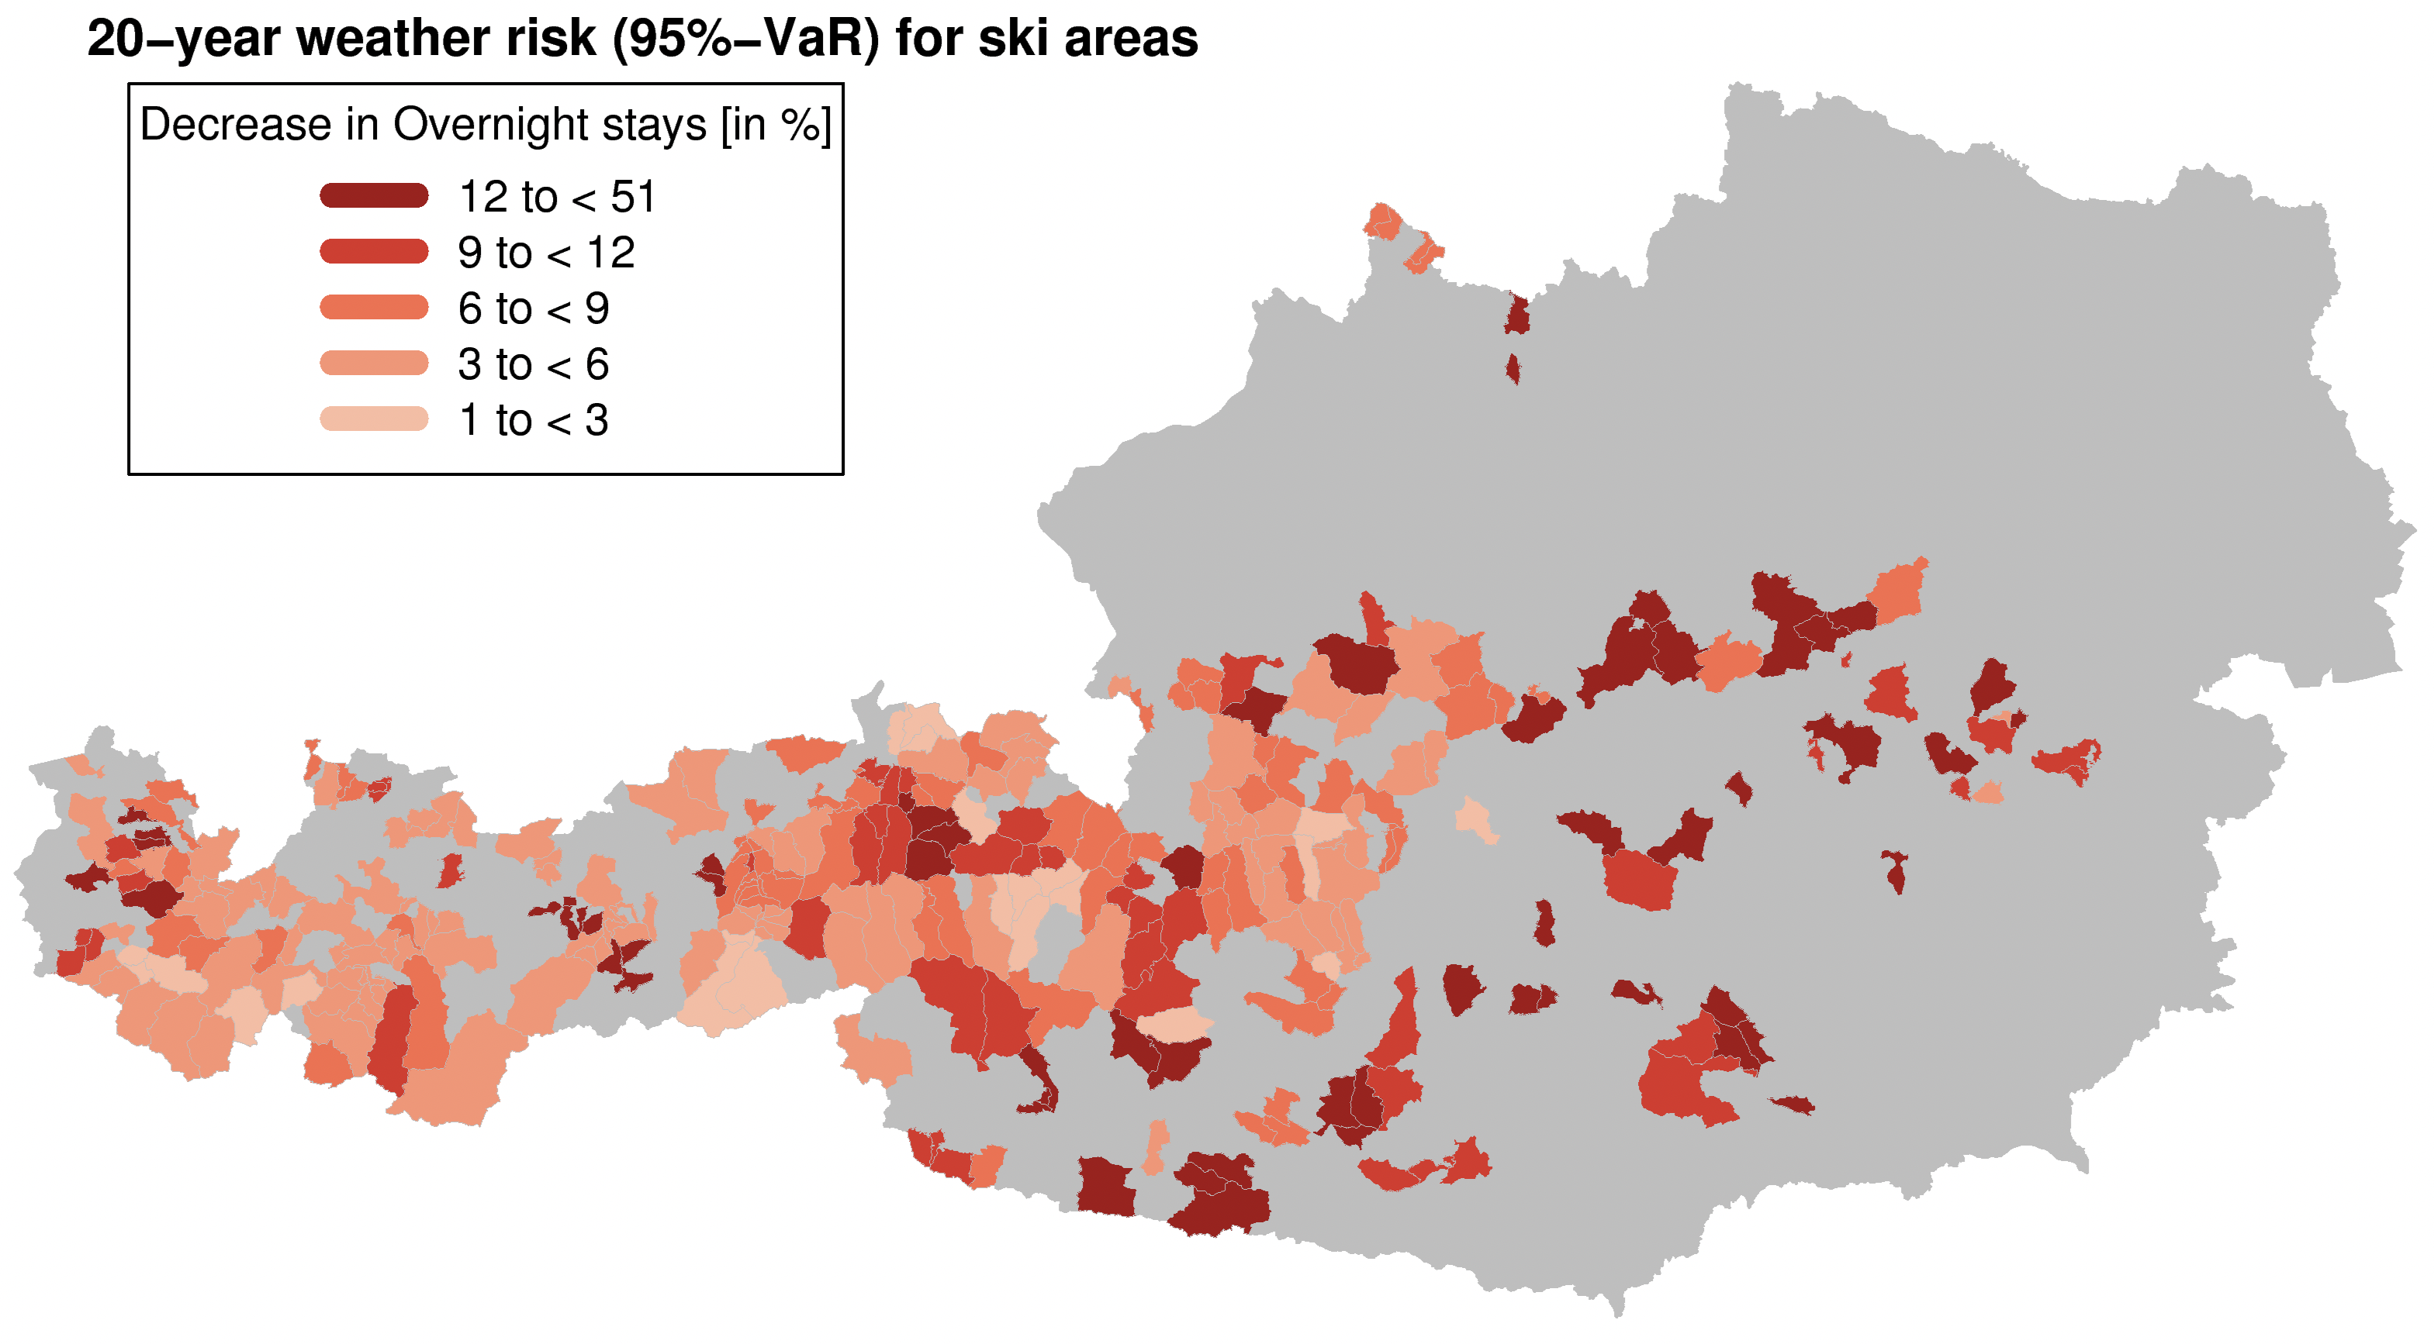

Slide 18
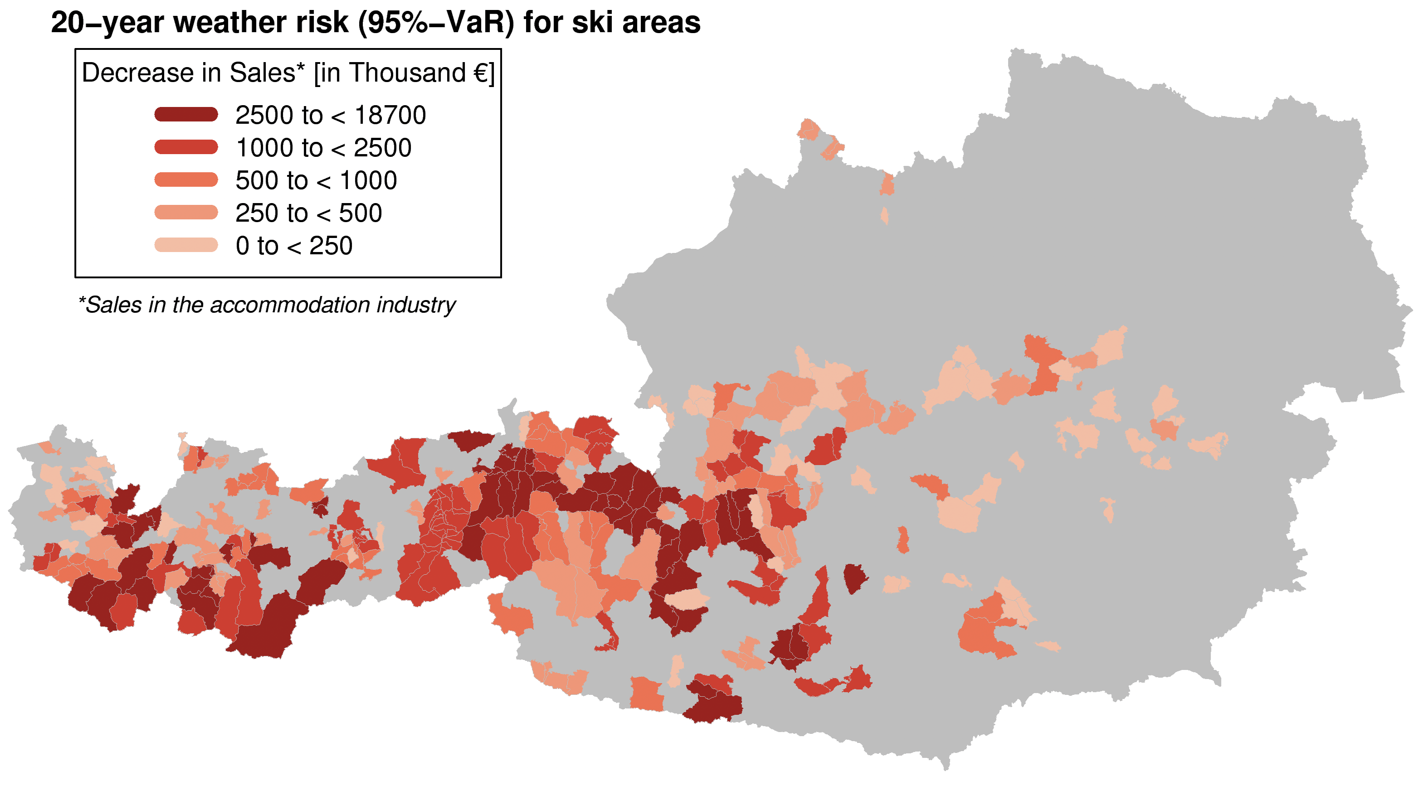

Slide 19
Elect icity

Slide 20
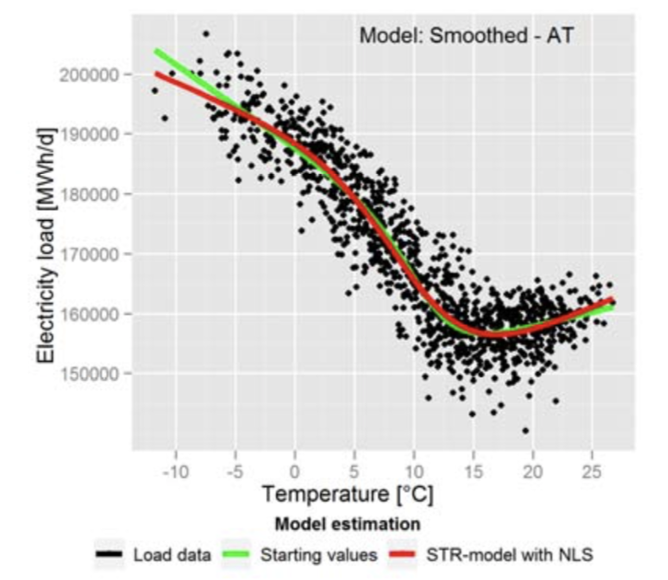
C. Töglhofer, C. Habsburg-Lothringen, F. Prettenthaler, N. Rogler, M. Themessl, 2012:
Impacts of Climate Change on Electricity Demand

Slide 21
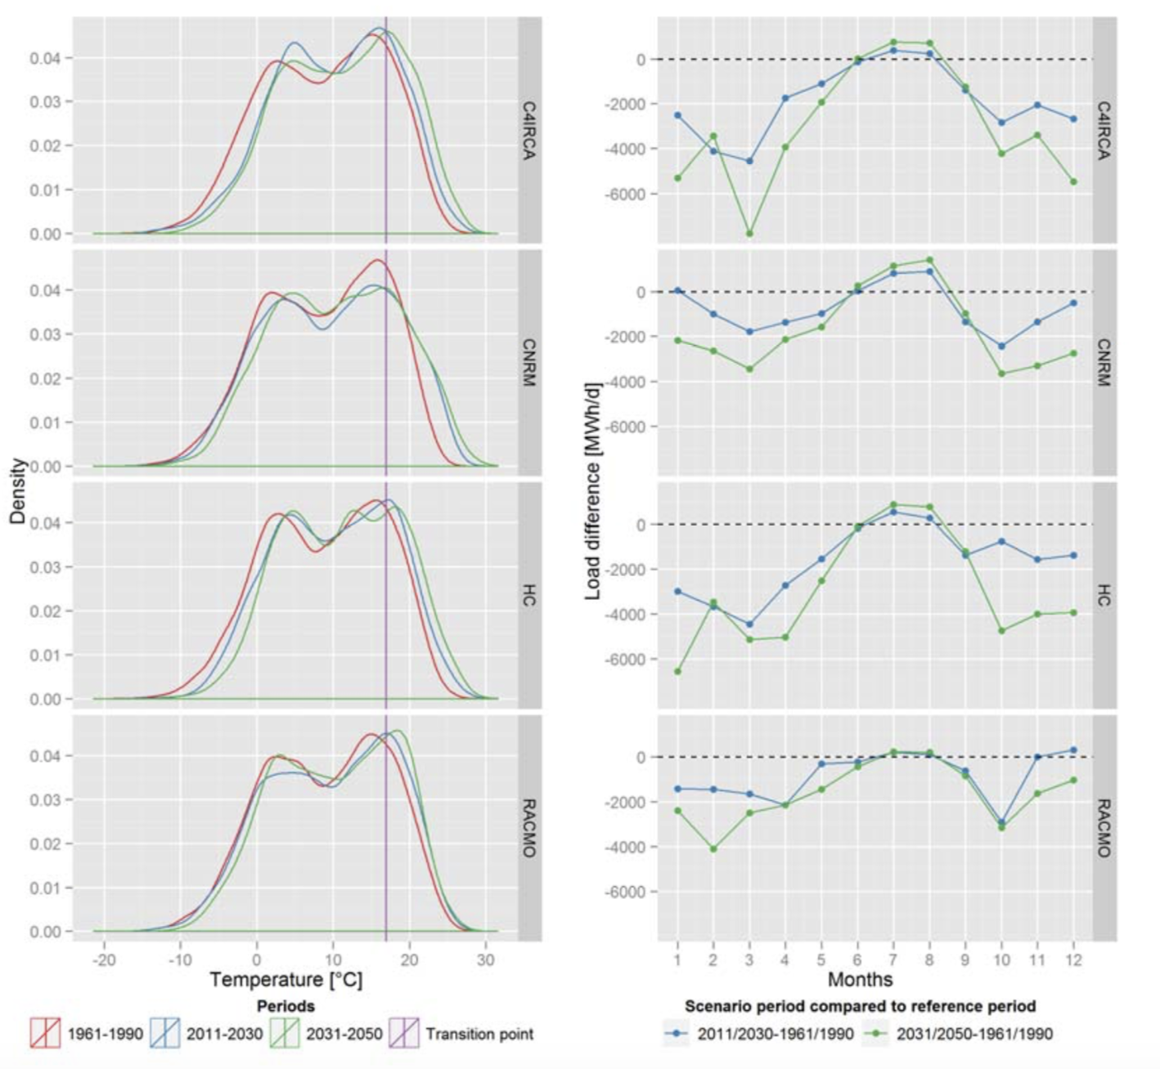

Slide 22
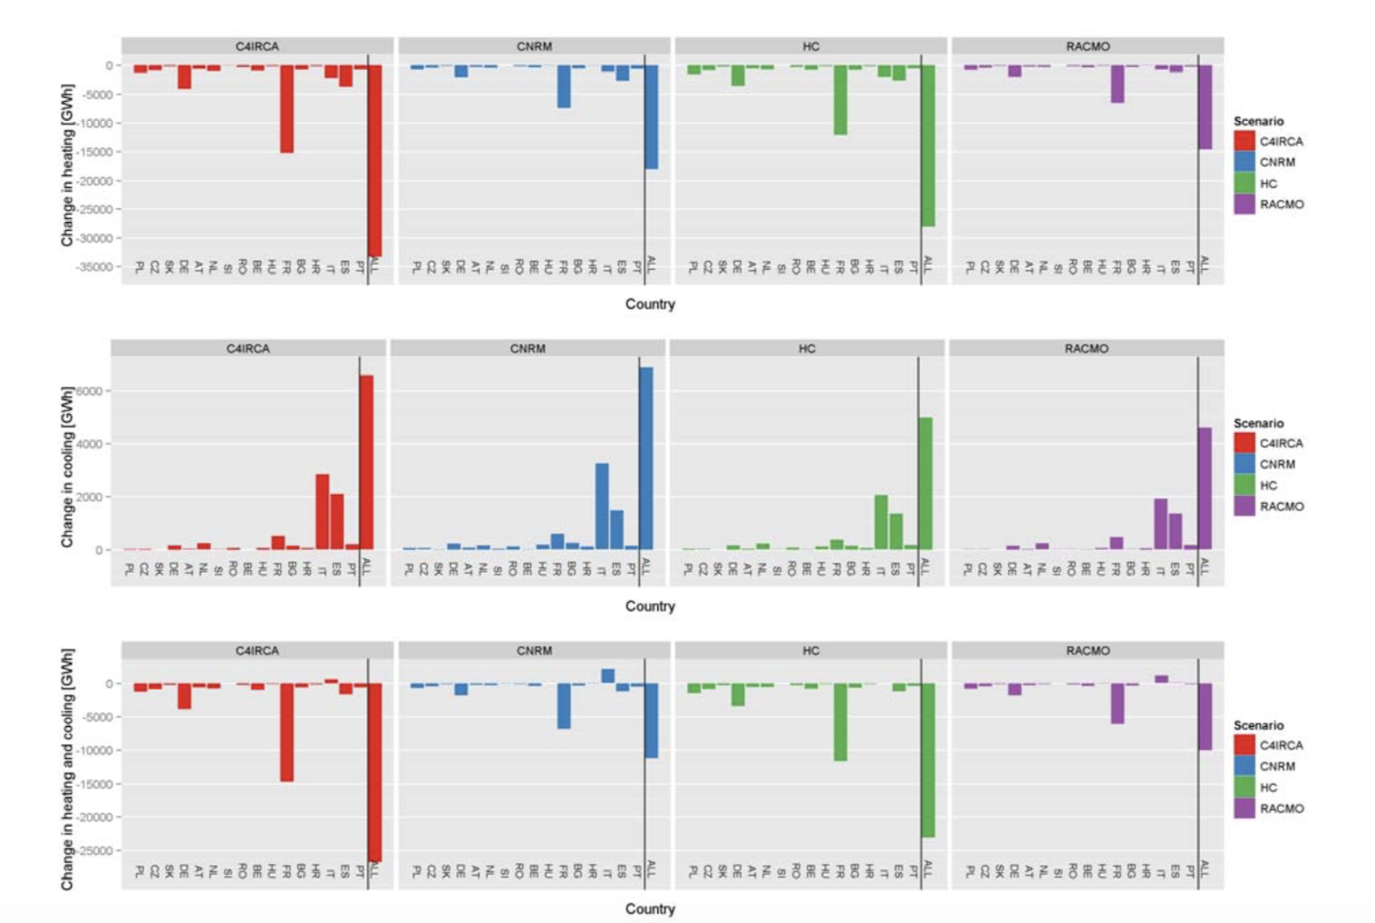

Slide 23
You Life

Slide 24
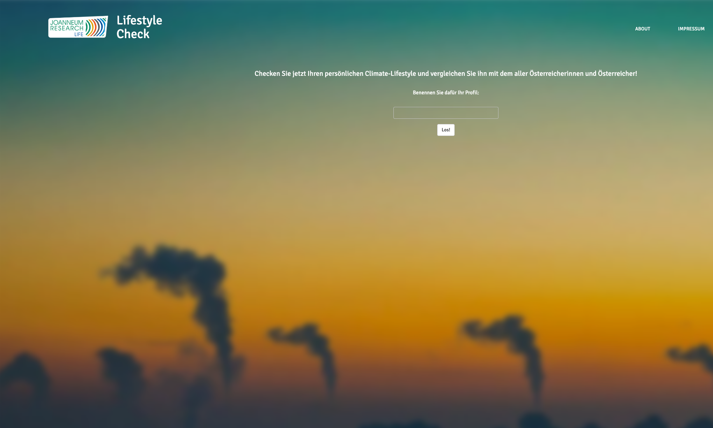
UI: Shiny
Chart:JS
Backend / models: R
R / JS
session$sendCustomMessage()
onInputChange().
jQuery, chart.js, Promises, future
https://lifestylecheck.at/

Slide 25
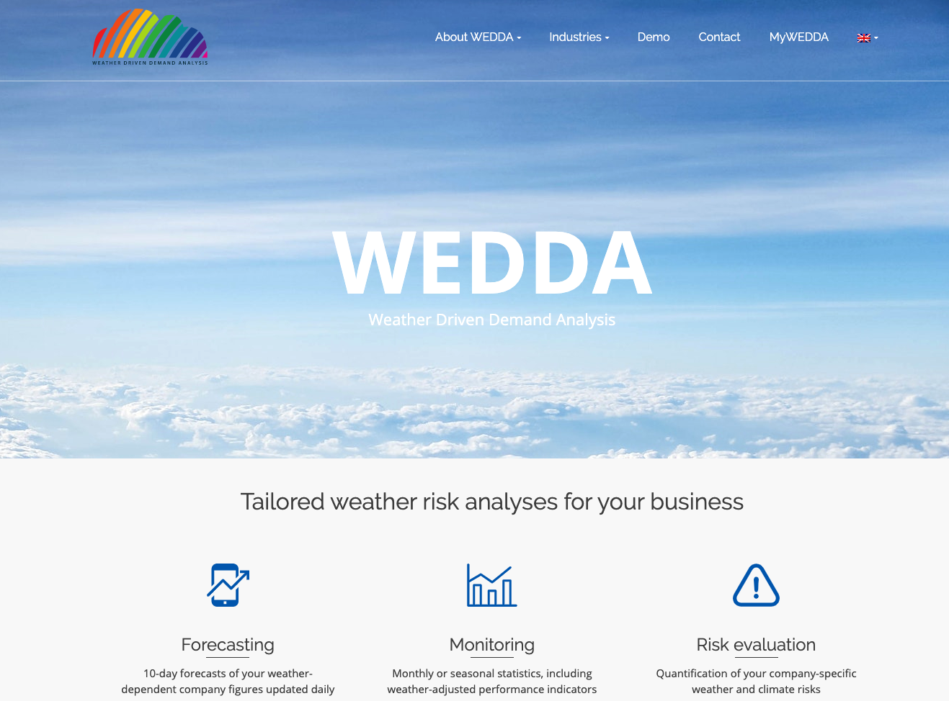

Slide 26
Perfo mance

Slide 27
Goliath
Slow
Large corporate
David
Fast
SW vendor

Slide 28

Ge ge

Slide 29


Slide 30

https://george-labs.com/

Slide 31
transforms banking with digital g(e)orgeousness.

Slide 32
combines design, technology, and personality into a comprehensive digital banking experience that simplifies and improves your very personal financial life.

Slide 33
has been the first, flexible work-horse for evaluating the user experience in the web and app version of the early days (activation funnels, feature acceptance)

Slide 34
Tech Stack

Slide 35
Insights Sharing
(First) Reporting Backend
Ad Hoc Reports
Liquidity Forecasting
Flex Dashboard
Ad Hoc Reports
PySpark
A/B Testing
Knowledge repo
https://rmarkdown.rstudio.com/flexdashboard/
https://github.com/airbnb/knowledge-repo

Slide 36
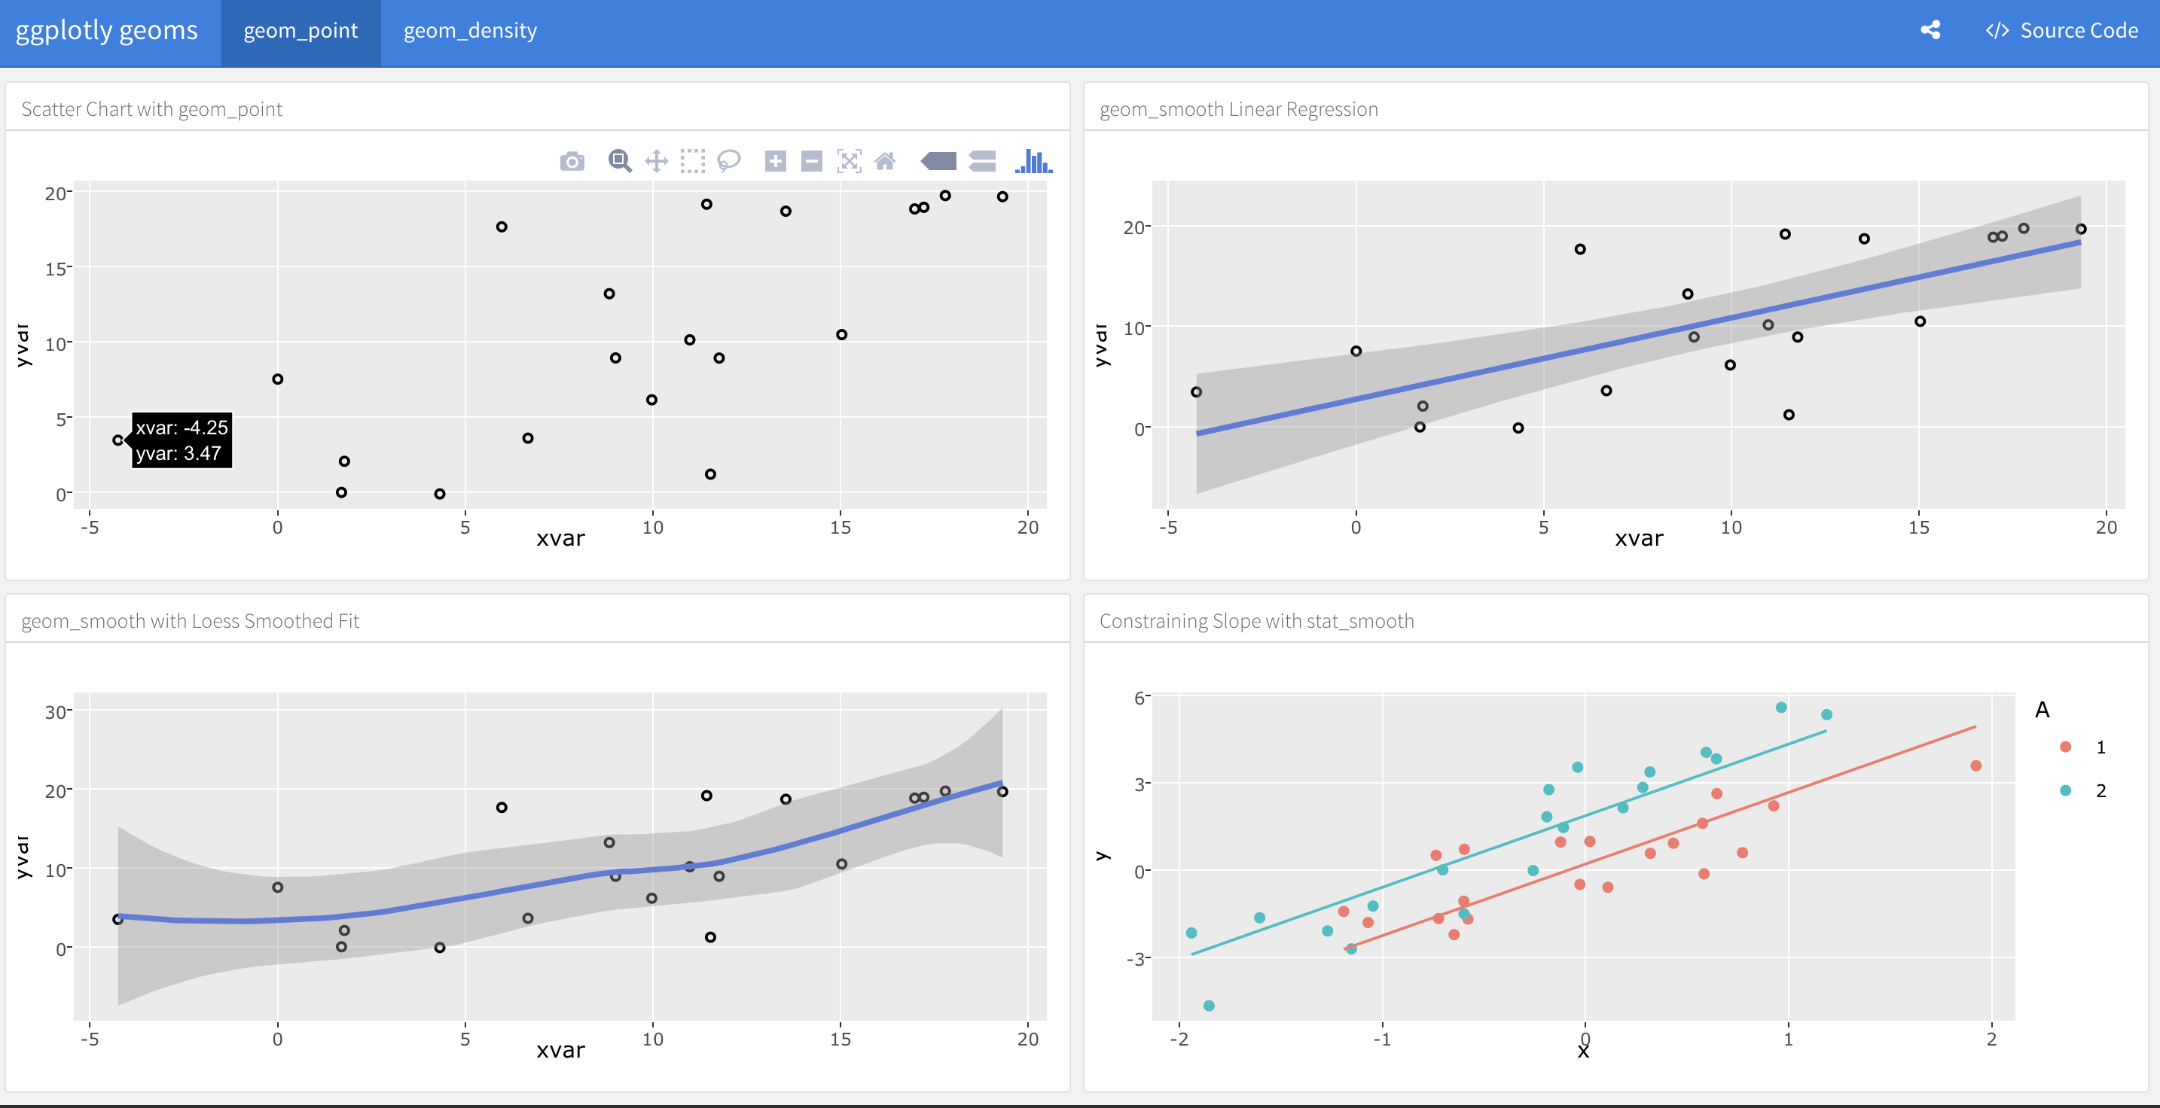
https://rmarkdown.rstudio.com/flexdashboard/

Slide 37
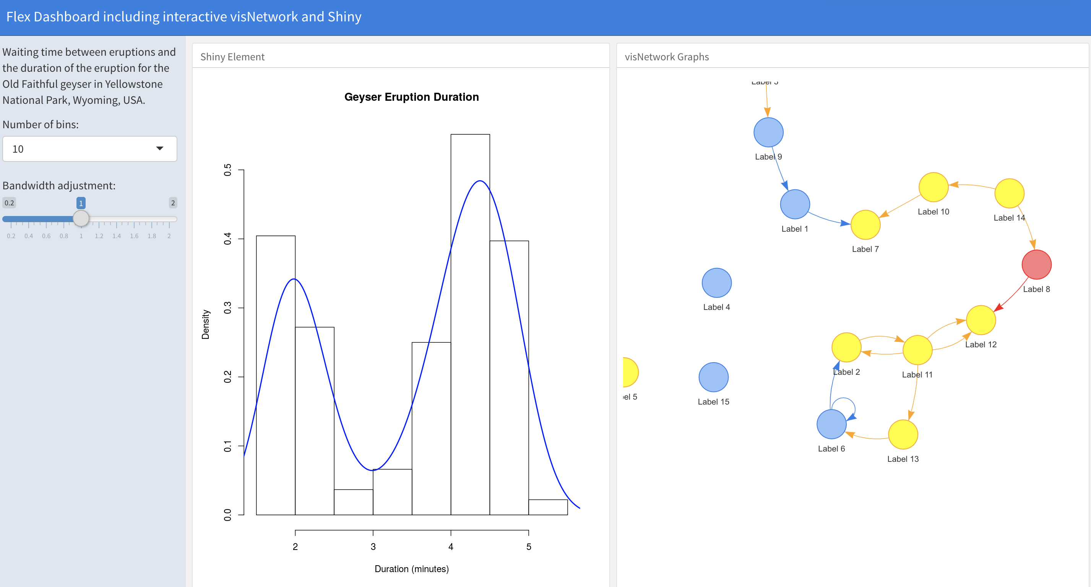
https://non-productivity-linked-ideas.shinyapps.io/FlexDashboard_template/

Slide 38
https://github.com/airbnb/knowledge-repo

Slide 39
P we up

Slide 40

https://george-labs.com/

Slide 41
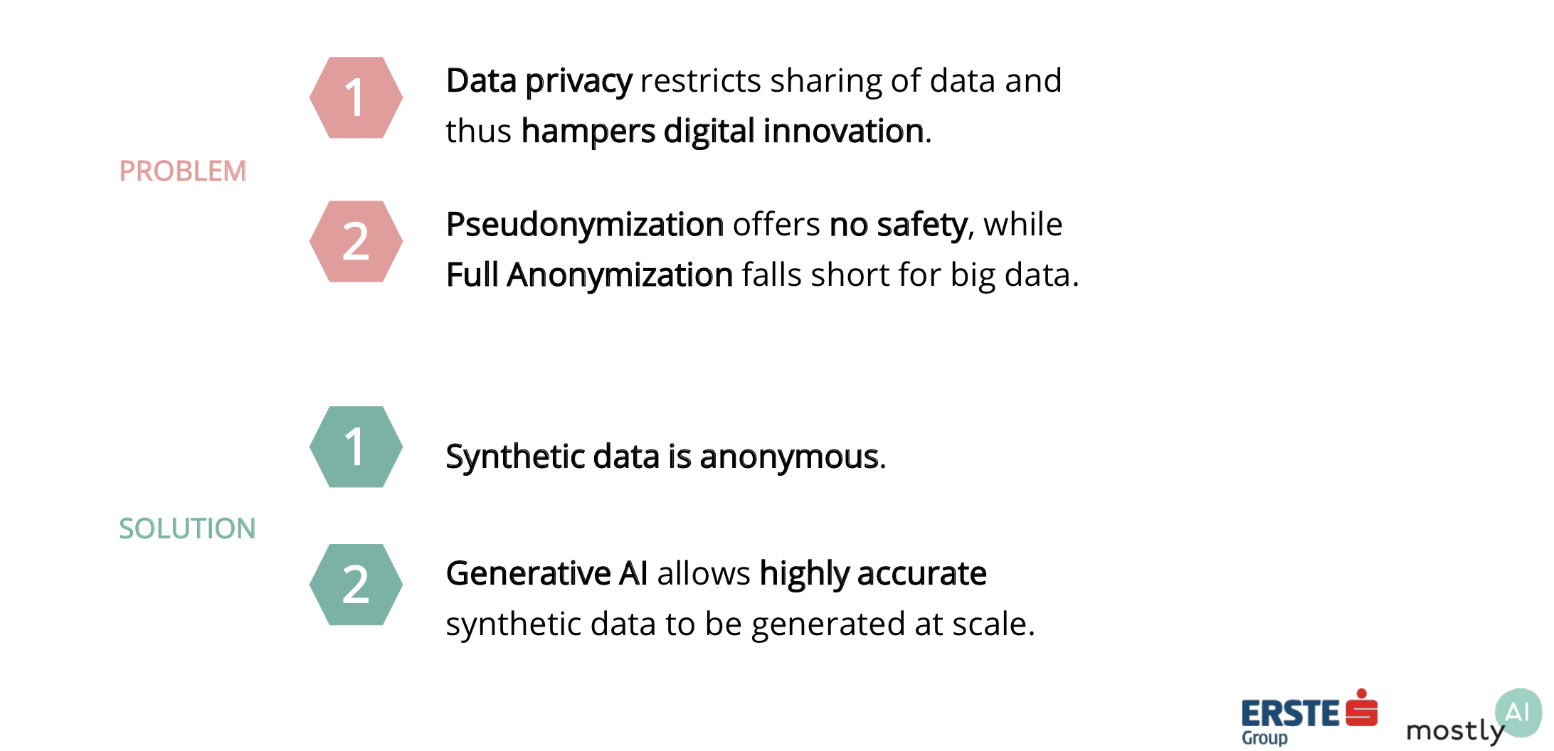
Synthetic data
M. Platzer, C. Toeglhofer 2018: Privacy-Preserving Sharing of Financial Transaction Data with Deep Generative Models

Slide 42
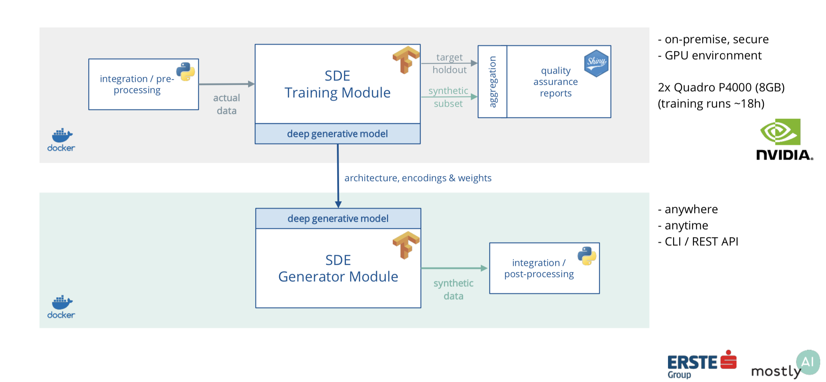
Tech Stack

Slide 43
Summa y

Slide 44
R as the workhorse for many applications
Spatial & artistic plots
connecting to data bases for data retrieval
Self-developed backends for research applications
Interactive Dashboards and ad-hoc analysis
Quality assurance reports for machine learning

Slide 45
ctoegi
Christoph Töglhofer

